Slide 1
Apache Kafka Deep Dive
Event Streaming Backbone for Scalable Systems

Slide 2
Why Kafka Exists
Traditional systems = tightly coupled + synchronous
Problems:
Scalability bottlenecks
Data loss risk
Backpressure issues
Kafka solves:
High throughput
Decoupling
Real-time processing

Slide 3
What is Kafka
Open-source distributed event streaming platform
Works as both a message queue and a stream processing system
Designed for high performance, scalability, and durability
Handles large volumes of real-time data efficiently
Provides fault tolerance with replication and acknowledgments
Ensures strong guarantees against message loss when properly configured

Slide 4
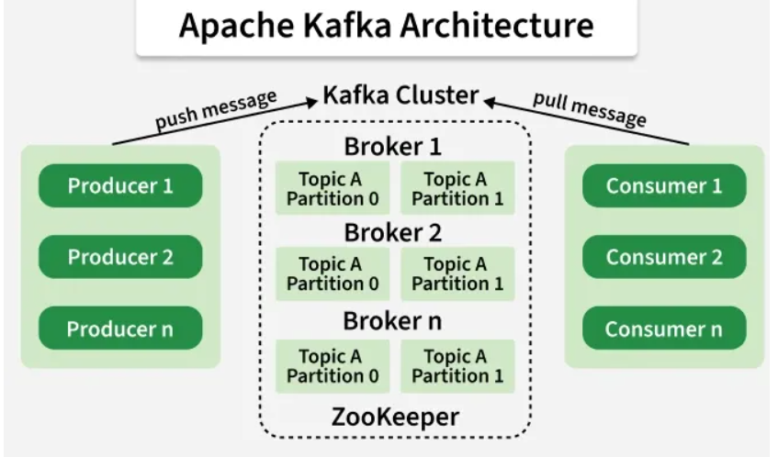
Core Components
Producer -> sends data
Consumer -> reads data
Broker -> server storing data
Topic -> logical category of messages
Partition -> split of topic for scalability
Consumer Group -> parallel processing

Slide 5
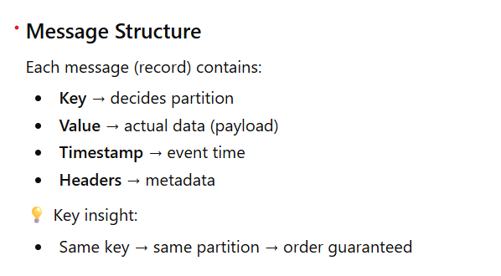
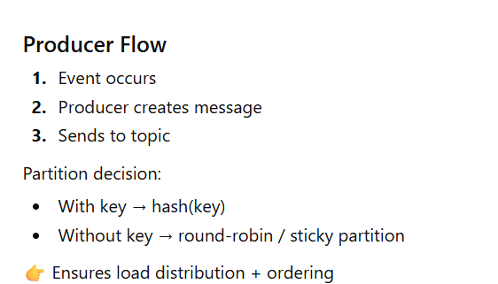
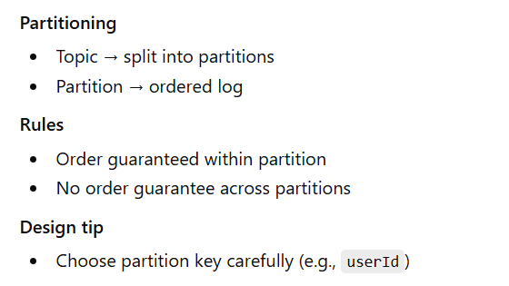
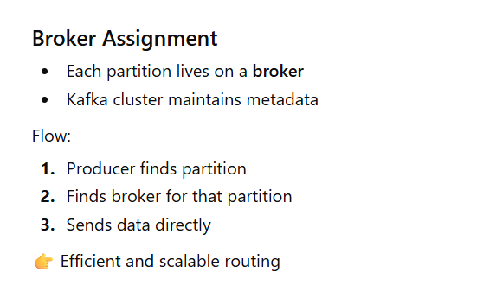
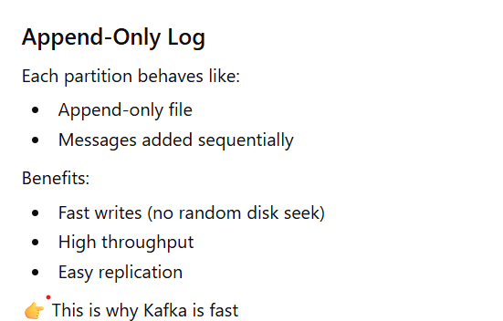
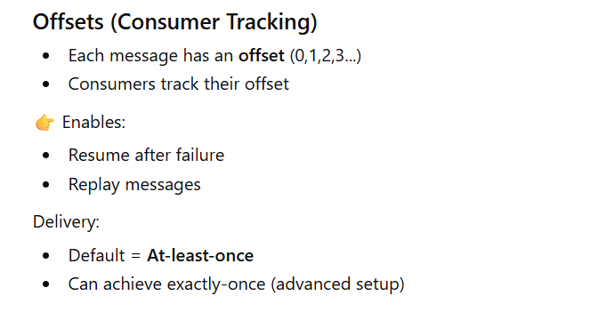
How Kafka Works

Slide 6
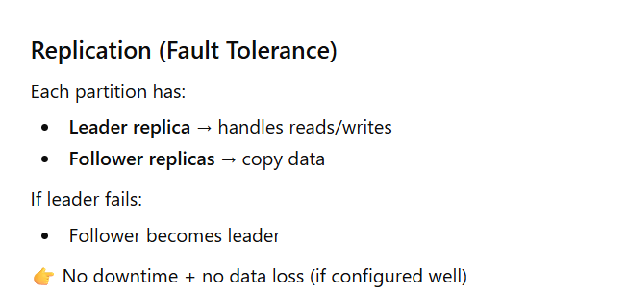
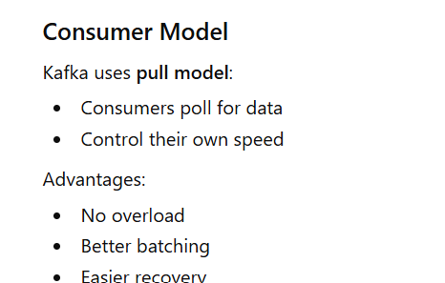
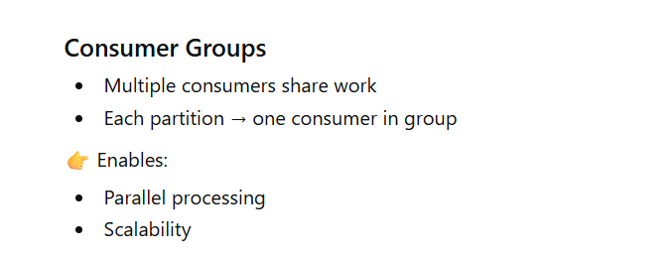
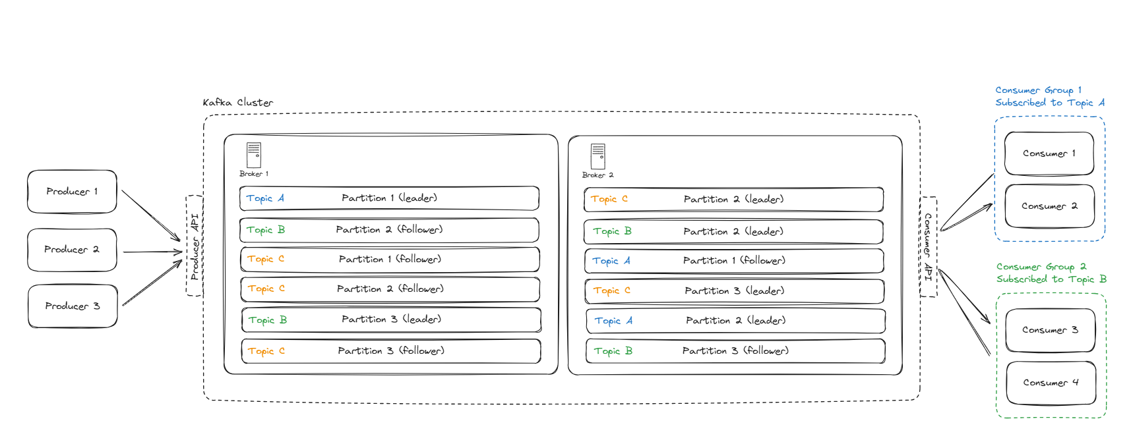

Slide 7
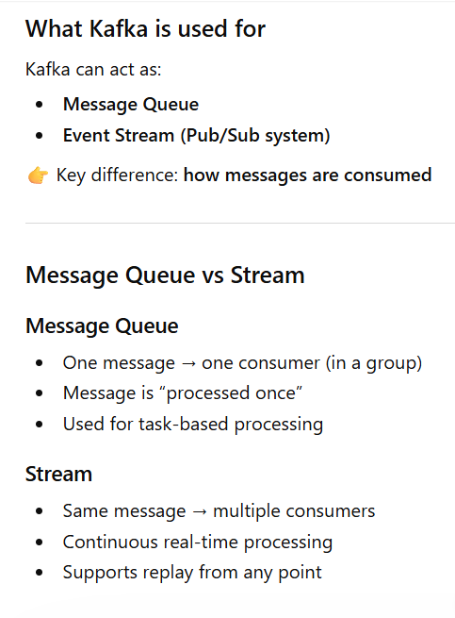
When to use Apache Kafka

Slide 8
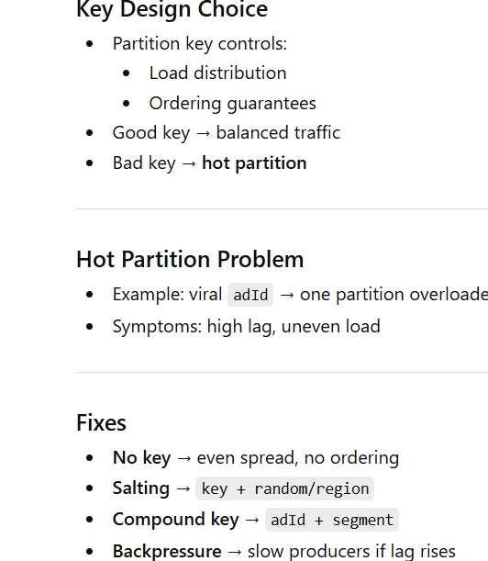
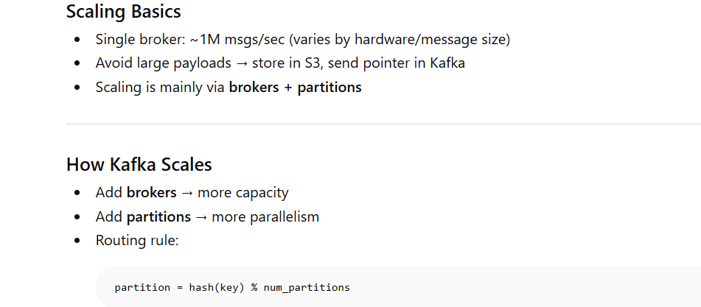
Important Attributes of Kafka
Scalability

Slide 9
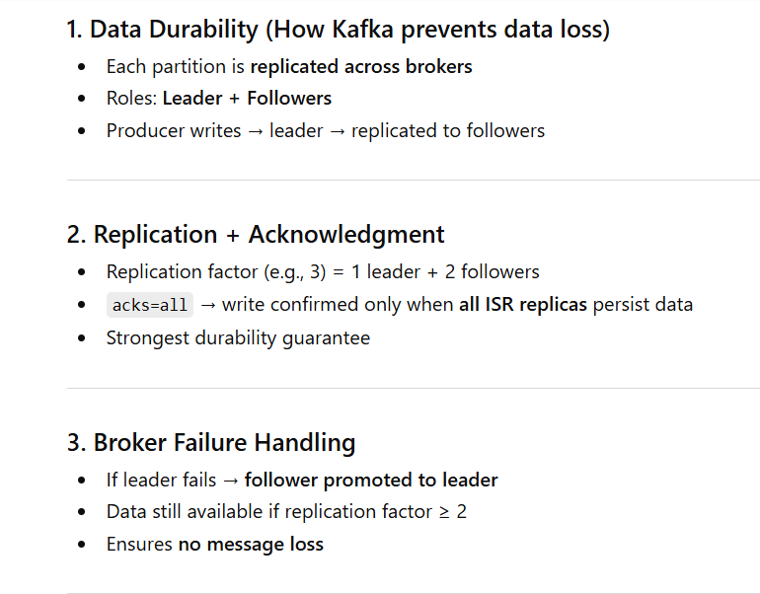
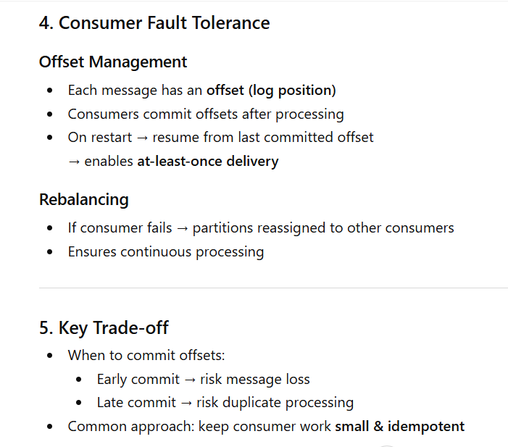
Kafka Fault Tolerance & Durability

Slide 10
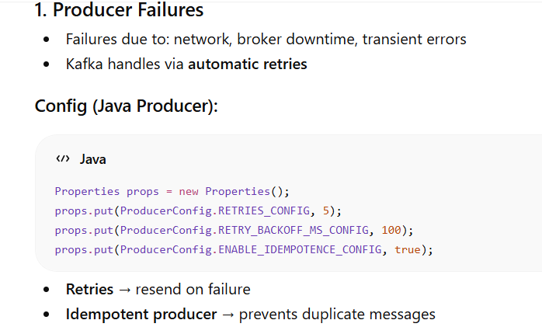
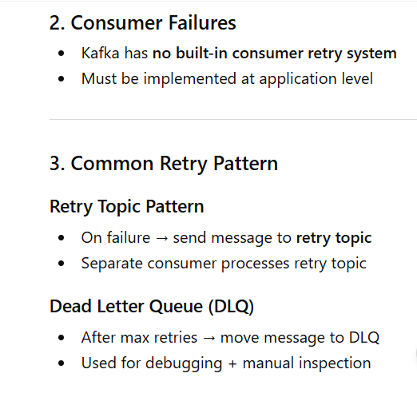
Kafka Handling Retries & Errors

Slide 11
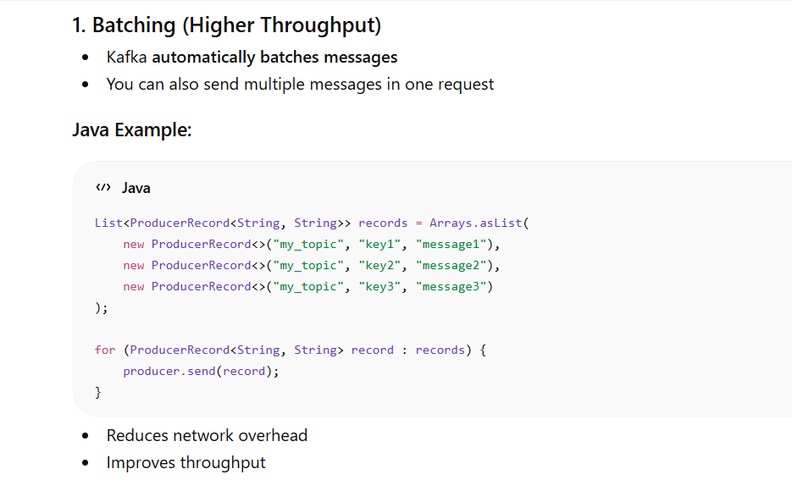
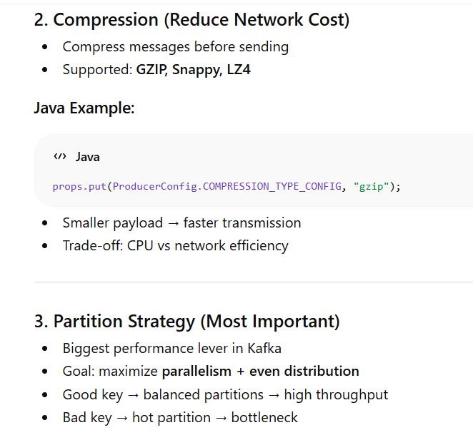
Performance Optimizations

Slide 12
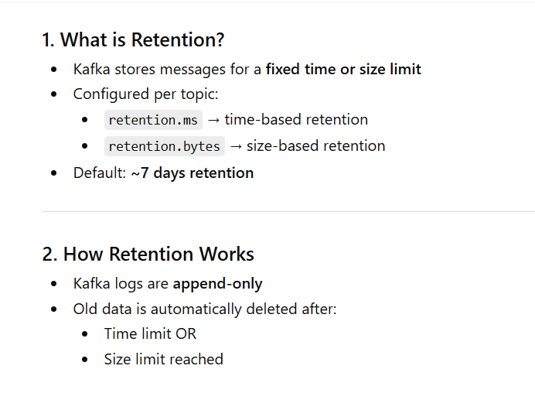
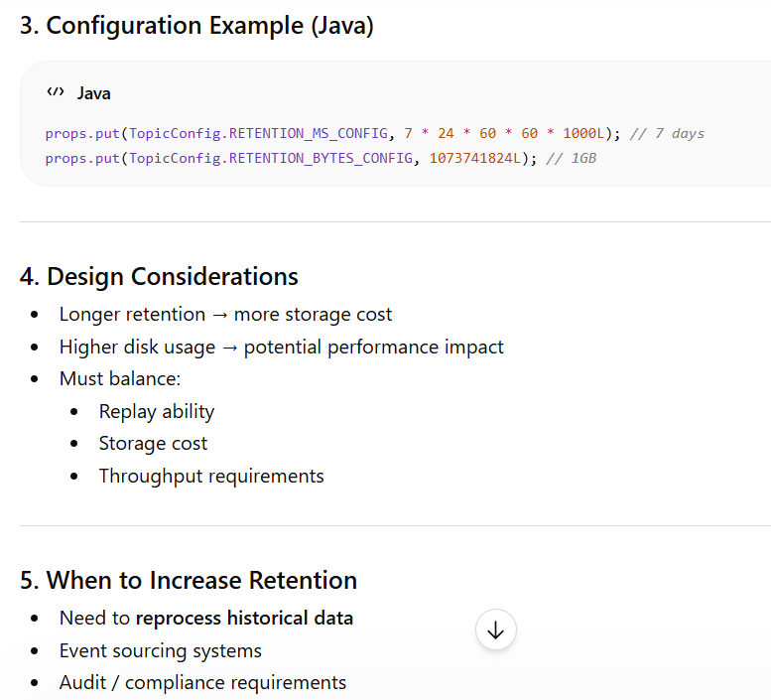
Kafka Retention Policies

Slide 13
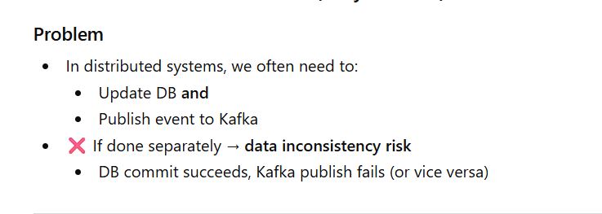
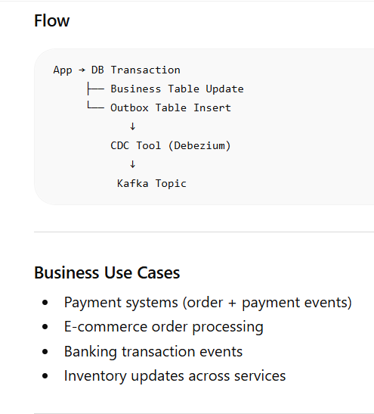
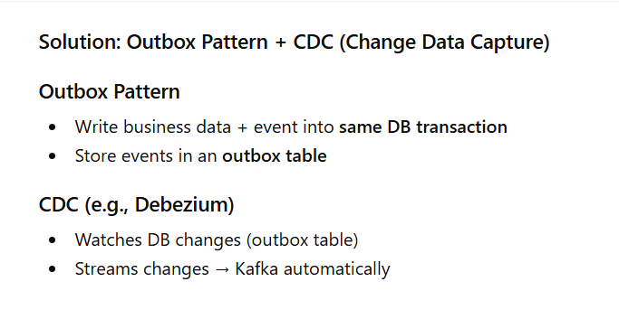
CDC + OUTBOX

Slide 14
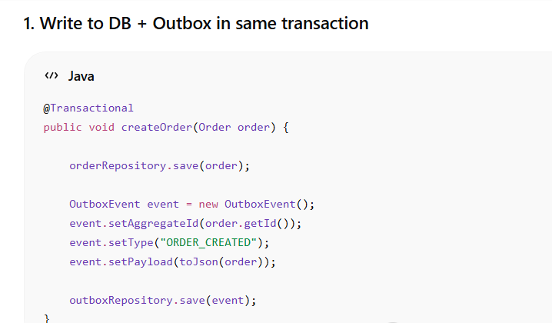
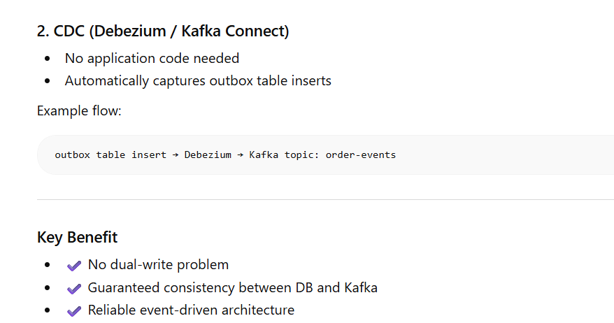
Outbox Pattern Implementation

